Slide 1
Image Processing

Slide 2
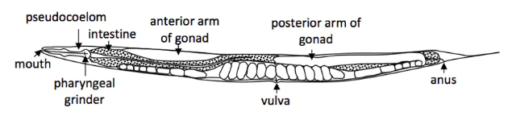
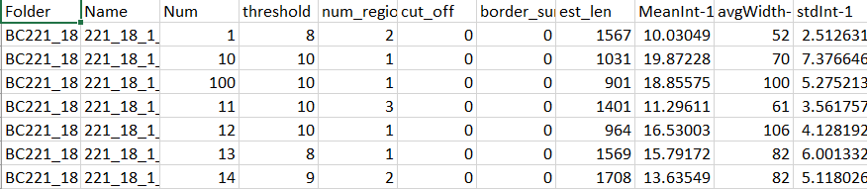
Overview
Ground Truth
Worm Image
Feature Extraction
Feature Exploration
Feature Selection
PCA and Heat Maps
LDA, Lasso, Stepwise Logistic Regression

Slide 3
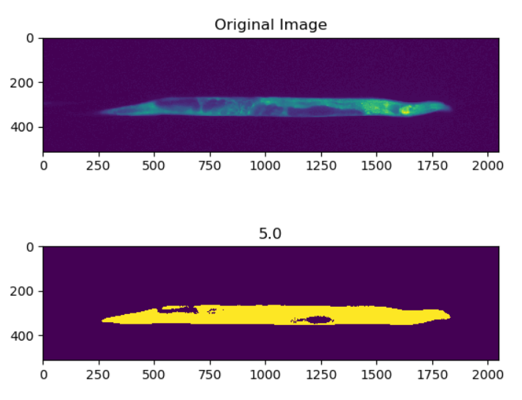
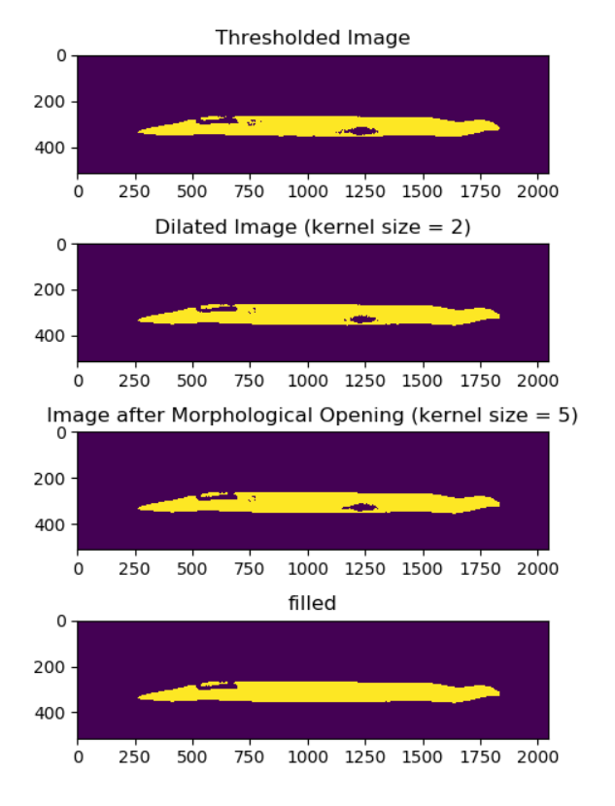
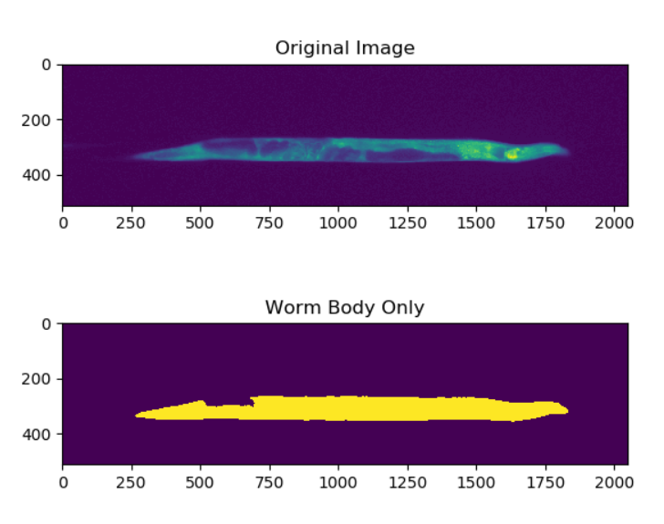
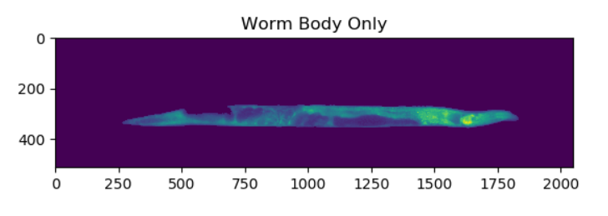
Feature Extraction
List of features we wanted to look at, how we determined those features
Worm Image

Slide 4
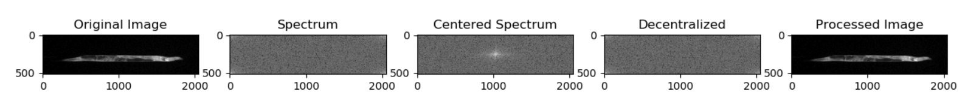
Feature Extraction
Fourier transformation

Slide 5
Feature Exploration: Correlation

Slide 6
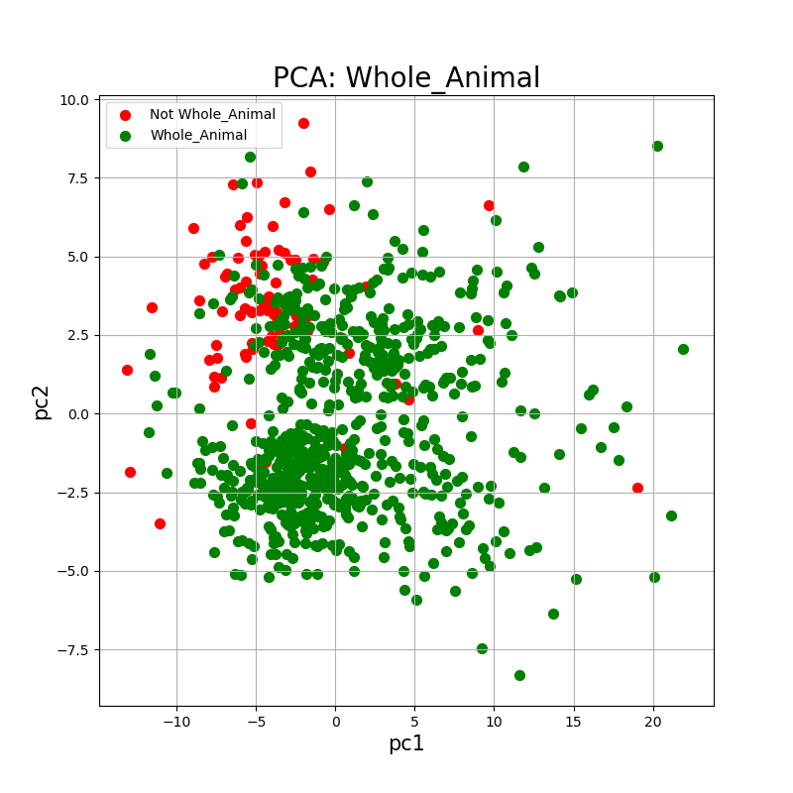
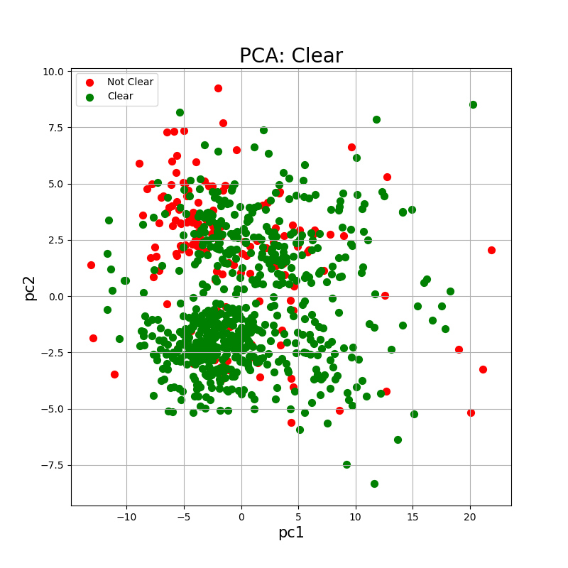
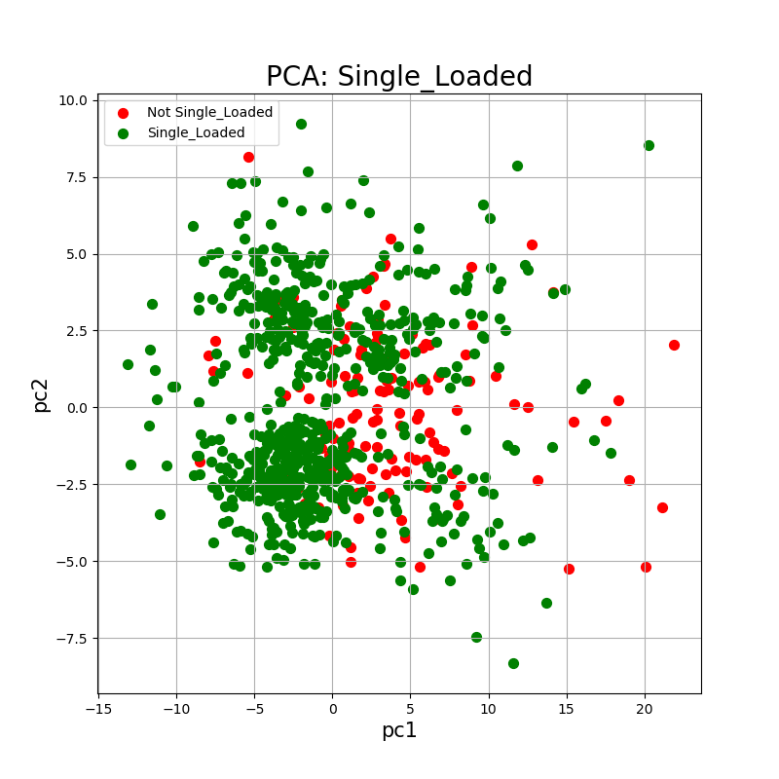
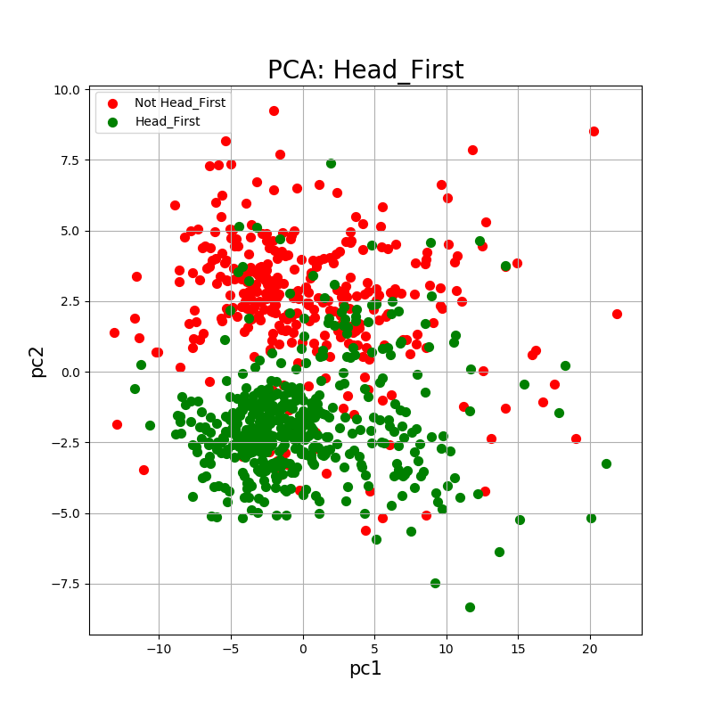
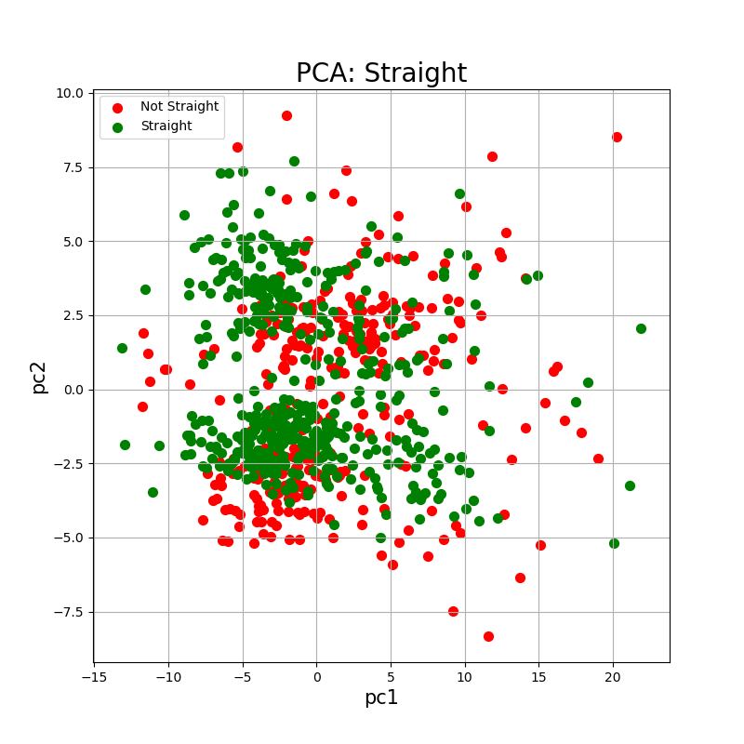
Feature Exploration: PCA
PCA with pc1 and pc2 for each feature

Slide 7
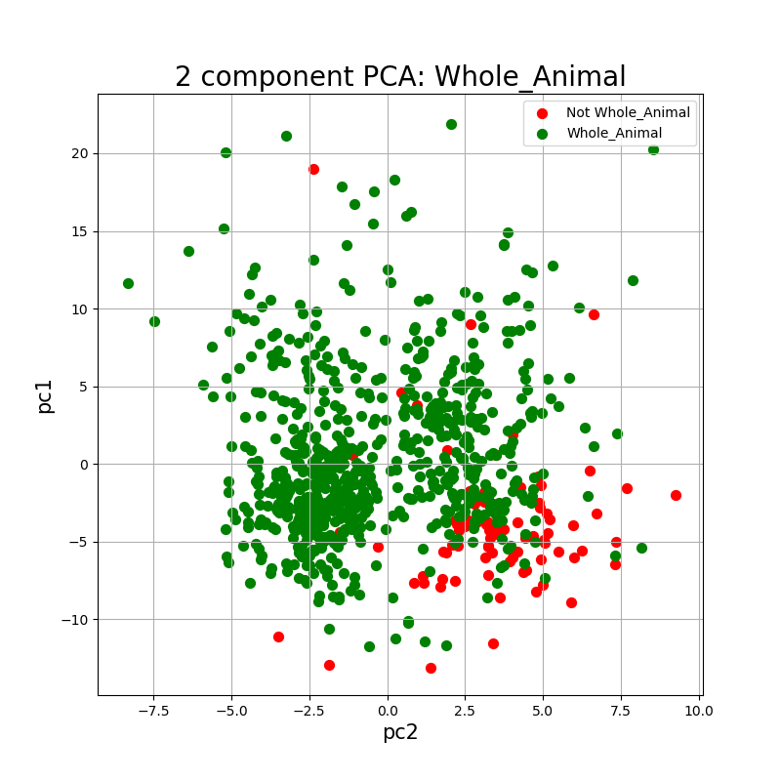
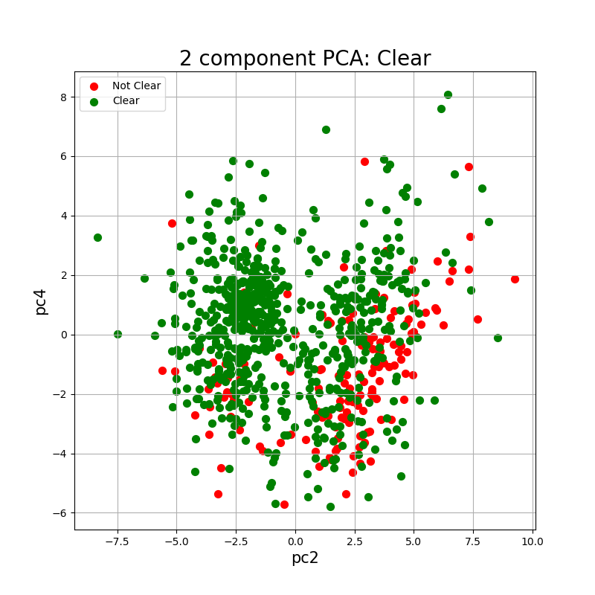
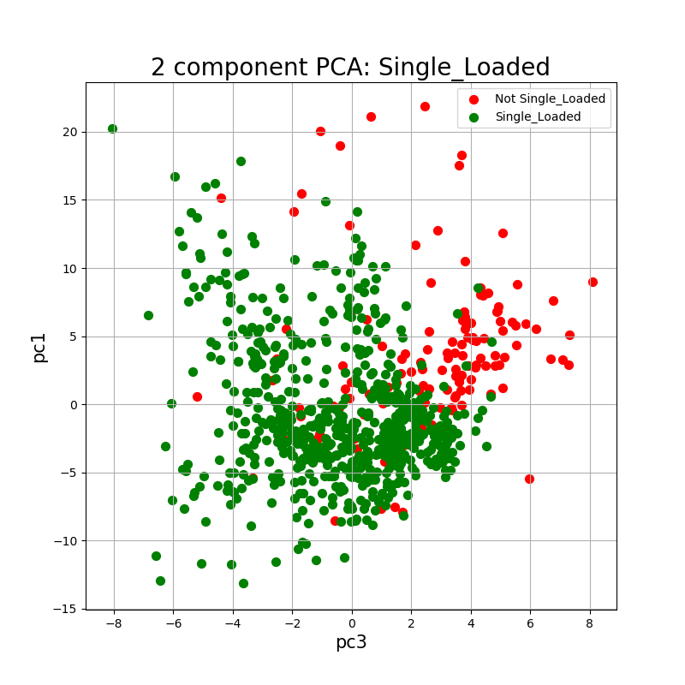
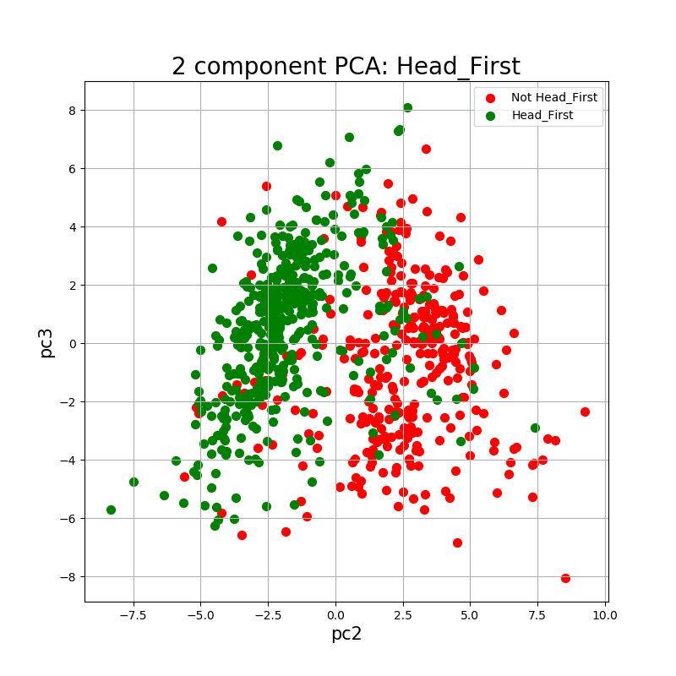
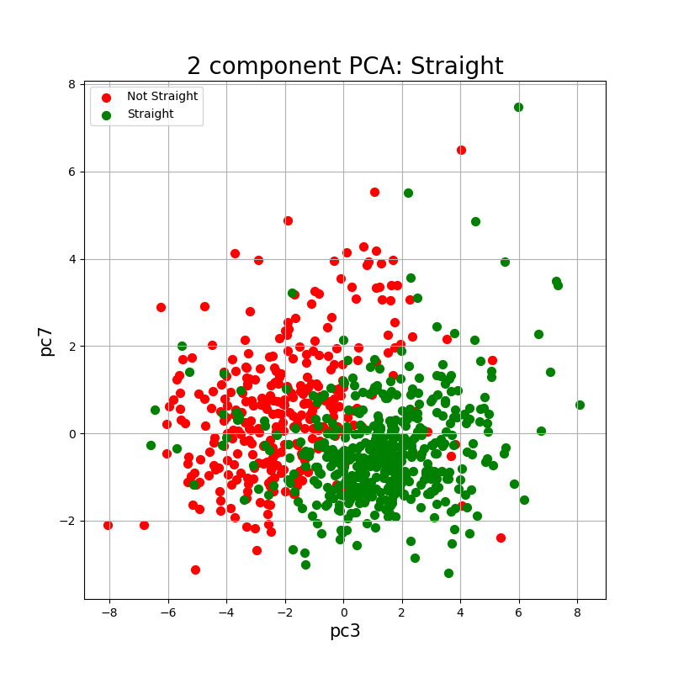
Feature Exploration: PCA
PCA with most highly correlated pcs
PCA on all data where n_components = 8-10
Not much better than just doing pc1/pc2 for everything
Notes:
Whole_animal: pc2/1
Clear: pc2/4
Single_Loaded: pc3/1
Head_First: pc2/3
Straight: pc3/7
Features: Num threshold num_regions est_len MeanInt-1 avgWidth-1 stdInt-1 perct95-1 medianInt-1 sumInt-1 MeanInt-2 avgWidth-2 stdInt-2 perct95-2 medianInt-2 sumInt-2 MeanInt-3 avgWidth-3 stdInt-3 perct95-3 medianInt-3 sumInt-3 MeanInt-4 avgWidth-4 stdInt-4 perct95-4 medianInt-4 sumInt-4 MeanInt-5 avgWidth-5 stdInt-5 perct95-5 medianInt-5 sumInt-5 MeanInt-6 avgWidth-6 stdInt-6 perct95-6 medianInt-6 sumInt-6 MeanInt-7 avgWidth-7 stdInt-7 perct95-7 medianInt-7 sumInt-7 MeanInt-8 avgWidth-8 stdInt-8 perct95-8 medianInt-8 sumInt-8 MeanInt-9 avgWidth-9 stdInt-9 perct95-9 medianInt-9 sumInt-9 MeanInt-10 avgWidth-10 stdInt-10 perct95-10 medianInt-10 sumInt-10 aspect_ratio intRatio2-9 tipWidthRatio BodMeanInt BodAvgWidth BodStdInt BodPerct95 BodMedianInt BodSumInt BKMeanInt

Slide 8




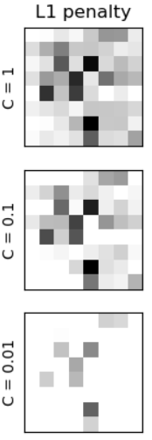
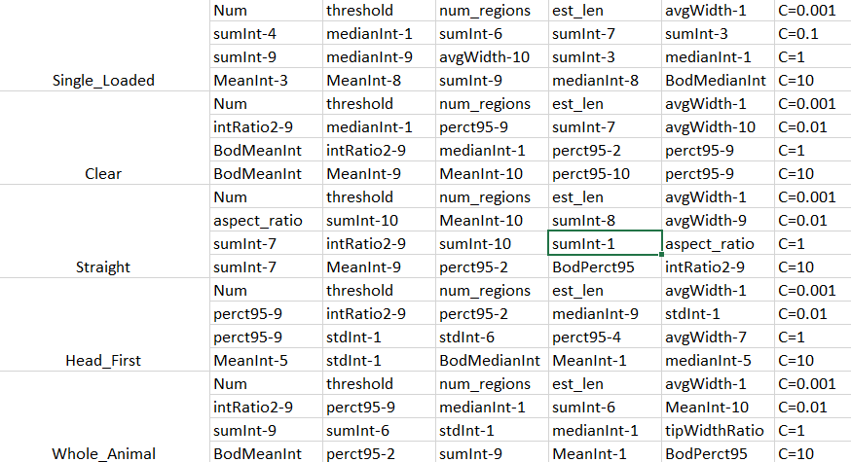
Feature Selection
L1 logistic regression
C = [10,1,0.1]
Notes:
B&W Image from https://scikit-learn.org/stable/auto_examples/linear_model/plot_logistic_l1_l2_sparsity.html
Looks like when you get the C value very low, the same variables come through for each feature: Num, threshold, num_regions, est_len, avgWidth-1, which are the first couple variables of the excel file (?). C decreases sparsity of the resulting coefficient matrix.

Slide 9
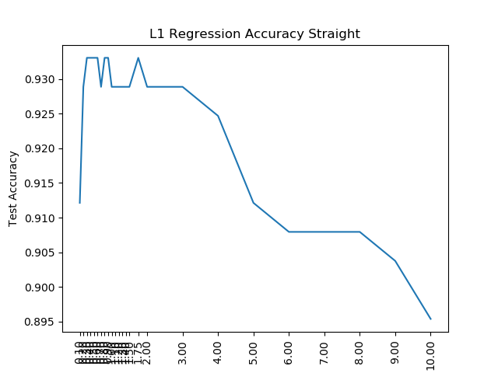
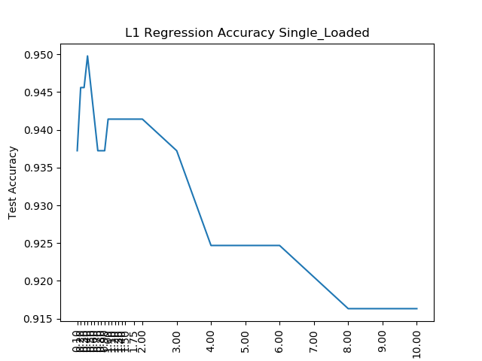
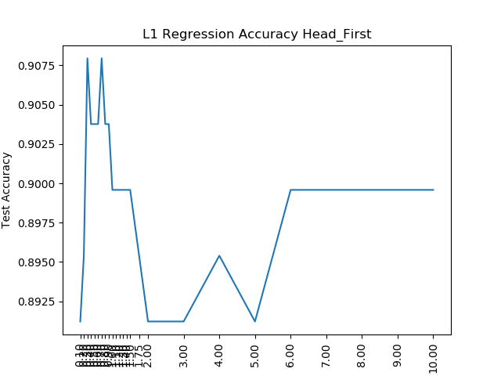
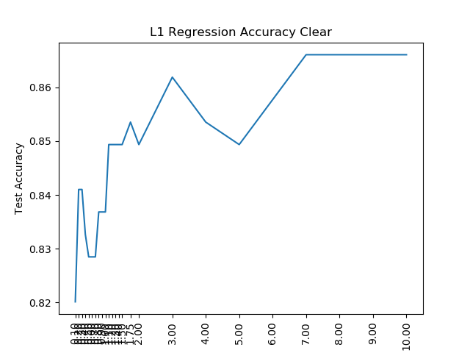
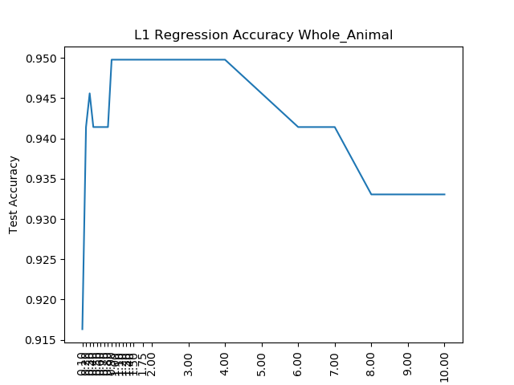
Notes:
Accuracy of the L1 regressor object on new testing data by value of C on the x axis

Slide 10
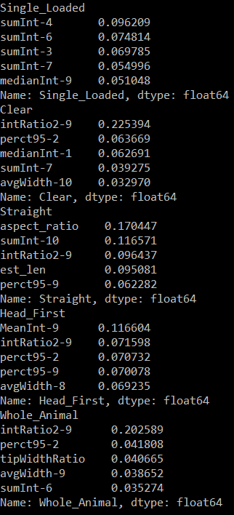
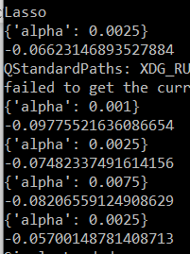
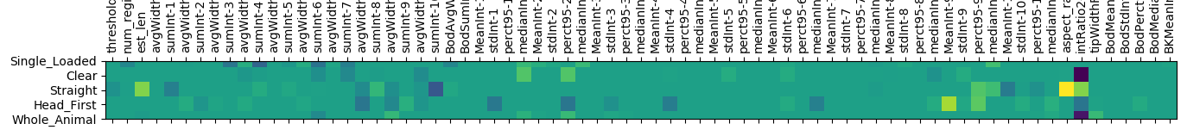
Feature selection
Highest weights for each feature with alpha value as 0.01
Lasso
Optimal alpha value
Notes:
Use GridSearchCV to test different alpha values (or different anything, really – quite a handy tool!)

Slide 11
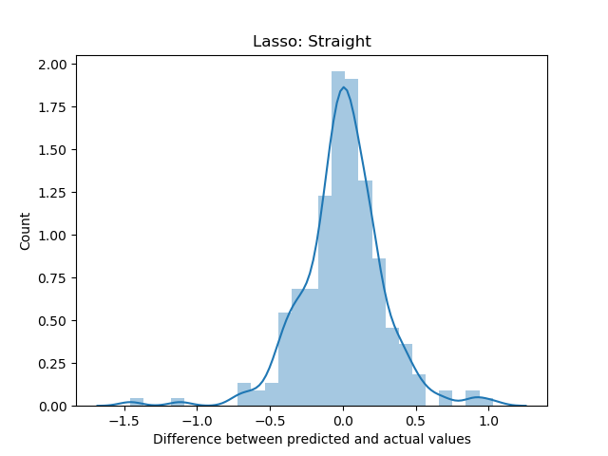
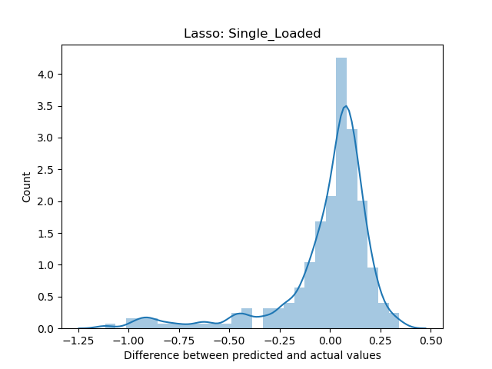
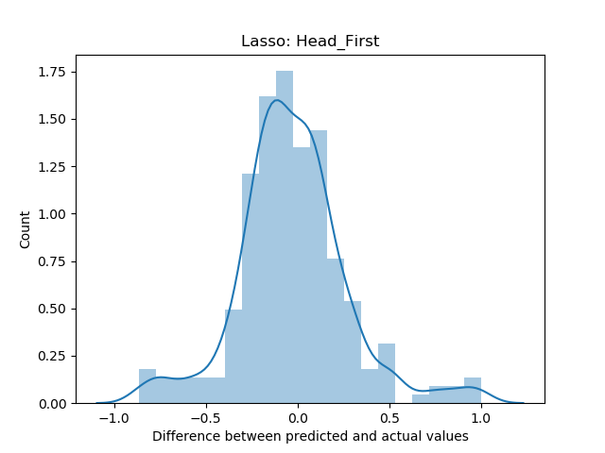
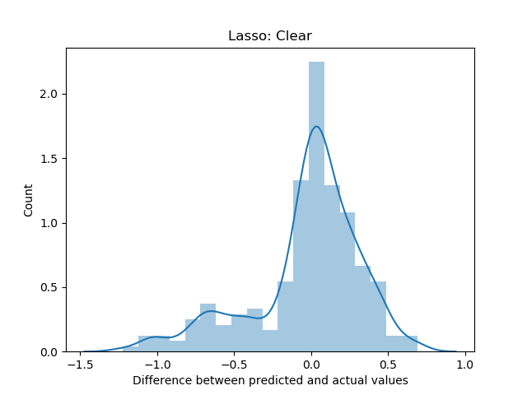
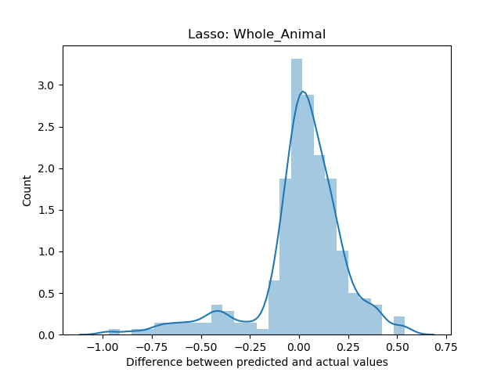
Notes:
For lasso with optimal alpha value

Slide 12
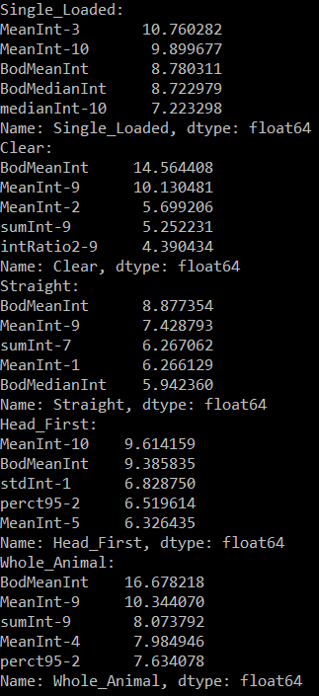
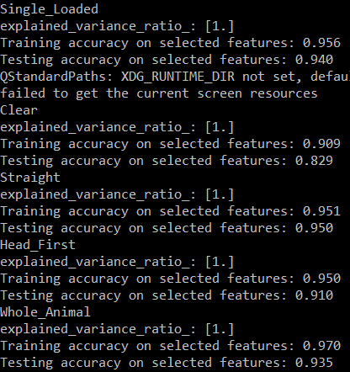
Feature Selection
Standard scaler → LDA
LDA on a binary classification (like ours) will only every project to one dimension
Good training/testing accuracy for all

Slide 13
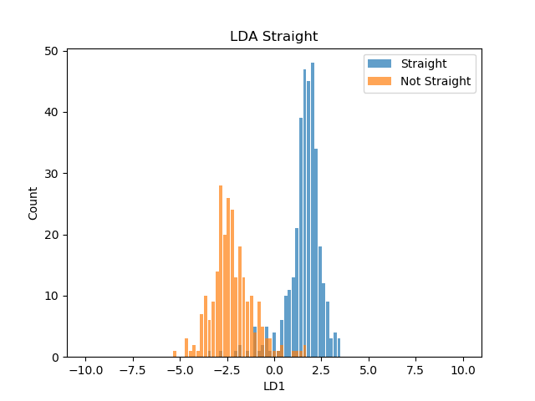
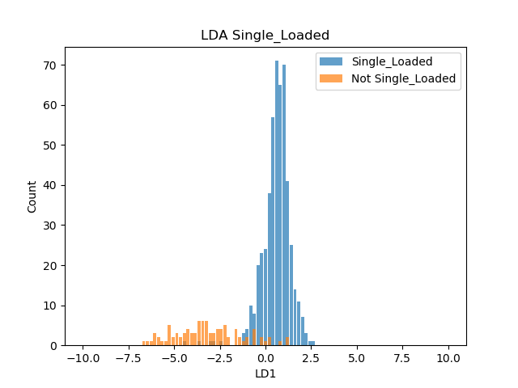
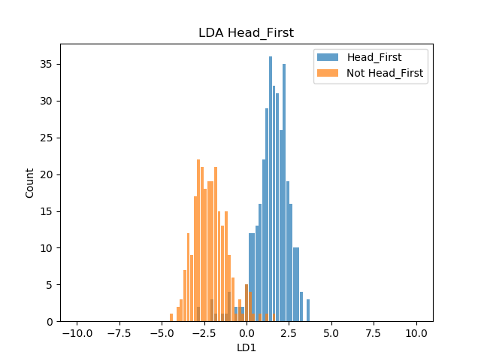
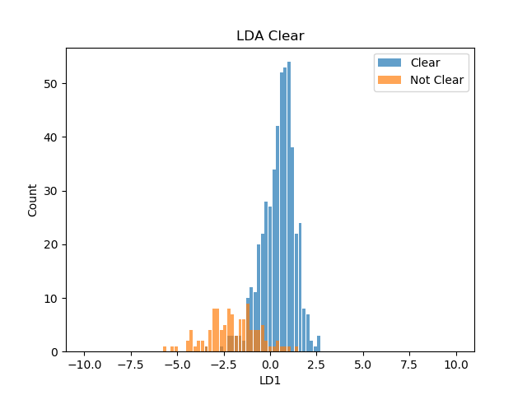

Notes:
Illustrates the distributions of each feature according to the projection done by LDA on the training data.

Slide 14
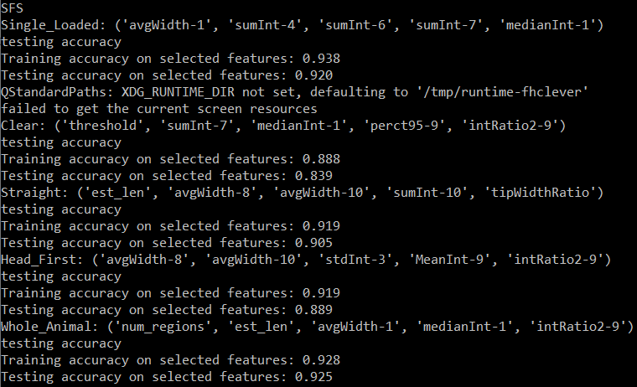
Feature selection
Step forward logistic regression
Good training/testing accuracy for all
Value of C for the logistic regression classifier – may want to change this, currently C = 0.1 but according to the L1 stuff we are doing, we can alter as desired
Notes:
I thought SFS was very interesting because after you perform the SFS, you get a list of features which best model the classification. Then you can do logistic regression on your classification using JUST the recommended features and see how accurate that is. The above screenshot details this. For example, SFS identified avgWidth-1, sumInt-4, sumInt-6, sumInt-7, ad medianInt-1 as the most salient features for the classification of the Single_Loaded feature. When you generate a logistic regression object using solely these features and use it to fit and model your data, then you get very high accuracy for the classification of single loaded vs. multiple loads.
Logistic regression notes:
Solvers: don’t seem to be a big deal as long as you standardize
https://stackoverflow.com/questions/38640109/logistic-regression-python-solvers-definitions
https://towardsdatascience.com/dont-sweat-the-solver-stuff-aea7cddc3451
Max_iter: https://www.naftaliharris.com/blog/visualizing-k-means-clustering/
N_jobs: -1 to use all processors, 1 for a single processor/core, 2 for two processors/cores, etc. – should just affect run time, not the results/outcome
Random_state: make sure this is the same everything you run logistic regression, otherwise your results will be shuffled/outcome will be different – does not matter what you set random_state equal to as long as it’s the same number

Slide 15
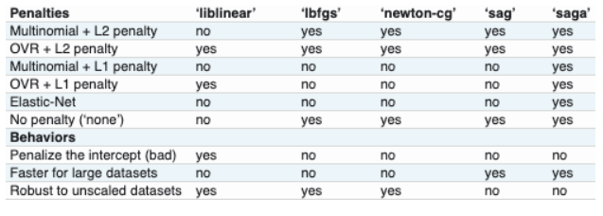
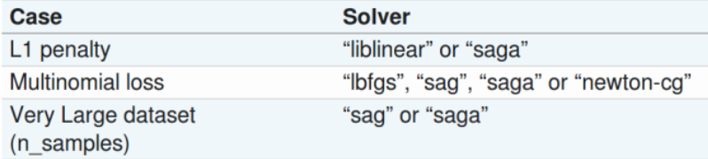
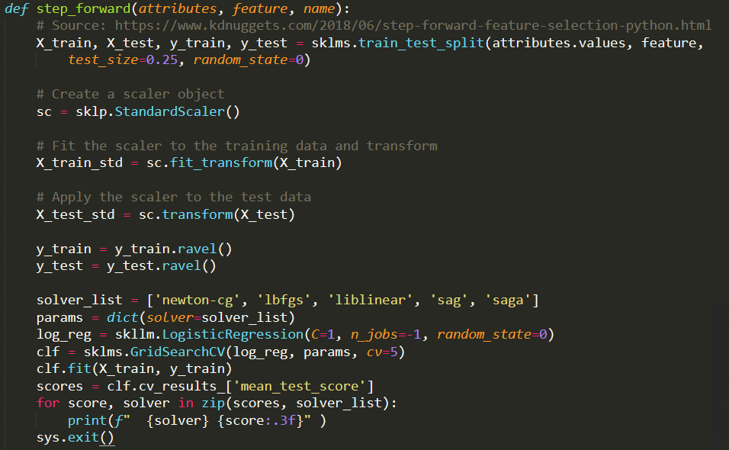
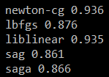
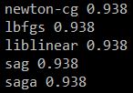
Logistic regression solver types
Notes on logistic regressor solver type
Accuracy by solver before and after data was standardized

Slide 16
